Slide 1
Cost of Living in the United States
BY: Ethan Pac
DATA 380 Final Project
April 28th, 2026

Slide 2
Dataset Overview
Presenting on Cost of Living in the United States using US Family Budget dataset
Content
31,000+ rows
15 variables
Covers 1,877 counties
Based on EPI Family Budget Calculator

Slide 3
Variables Used
Categorical Variables
state – U.S. state name
isMetro – Metro vs. non‑metro area
areaname – Metro area name
county – County name
family_member_count – Number of people in the family (treated as categorical for grouping)
Quantitative Variables
housing_cost
food_cost
transportation_cost
healthcare_cost
other_necessities_cost
childcare_cost
taxes
total_cost
median_family_income

Slide 4
Summary Statistics
Total costs varies significantly
Housing has a wide range (varies across region) and high variation making it a big driver of overall costs
Food costs are more stable compared to others
Median family incomes varies widely
Variable | Mean | Std Dev | Min | 25% | Median | 75% | Max
Housing Cost | 11,073 | 4,166 | 4,209 | 8,580 | 10,416 | 12,444 | 61,736
Food Cost | 8,288 | 3,271 | 2,220 | 5,801 | 8,129 | 10,704 | 31,179
Total Cost | 70,900 | 21,846 | 30,088 | 53,774 | 70,974 | 85,368 | 223,718
Median Family Income | 68,316 | 16,887 | 25,530 | 57,224 | 65,956 | 76,136 | 177,662

Slide 5
Data Cleaning
Removed missing values
Dropped case_id
Checked data types

Slide 6
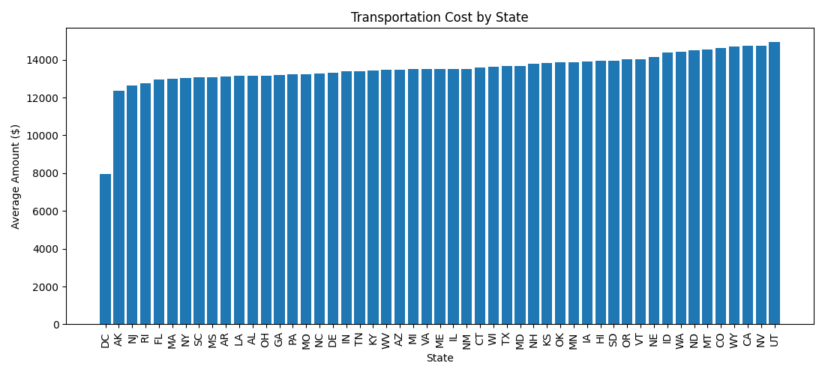
Transportation Cost by State
Costs are relatively consistent
Small variation across states

Slide 7
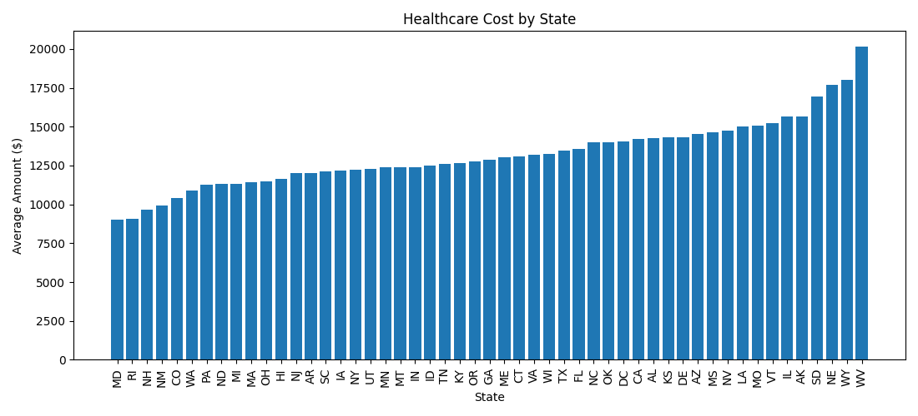
Healthcare Cost by State
More variation than transportation
Some states significantly higher

Slide 8
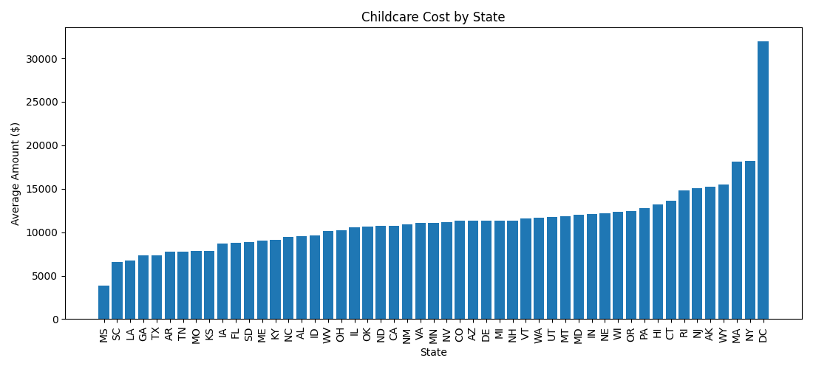
Childcare Cost by State
Very large differences
Highest in DC and NY

Slide 9
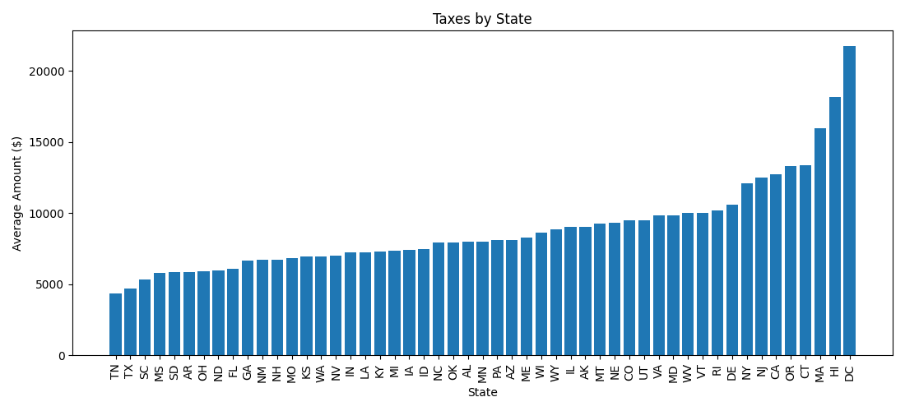
Taxes by State
Higher in CA, NY, DC
Lower in some southern states

Slide 10
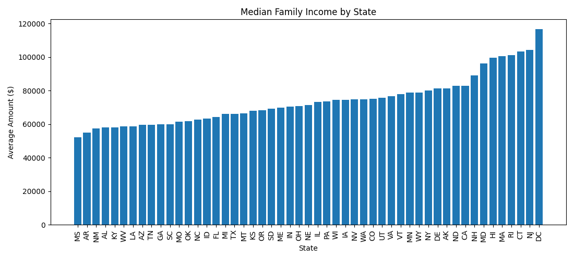
Median Income by State
Higher income = higher costs
Strong relationship

Slide 11
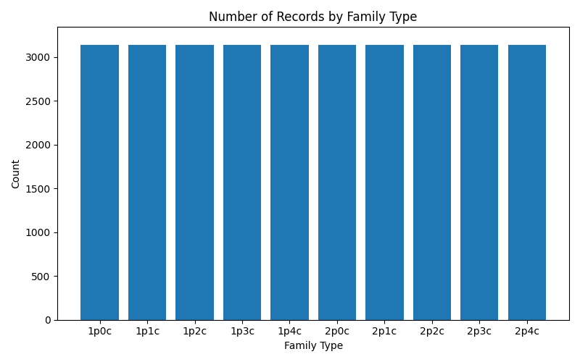
Number of Records by Family Type
Equal number of observations for each family type
Dataset is evenly distributed
No bias across family categories

Slide 12
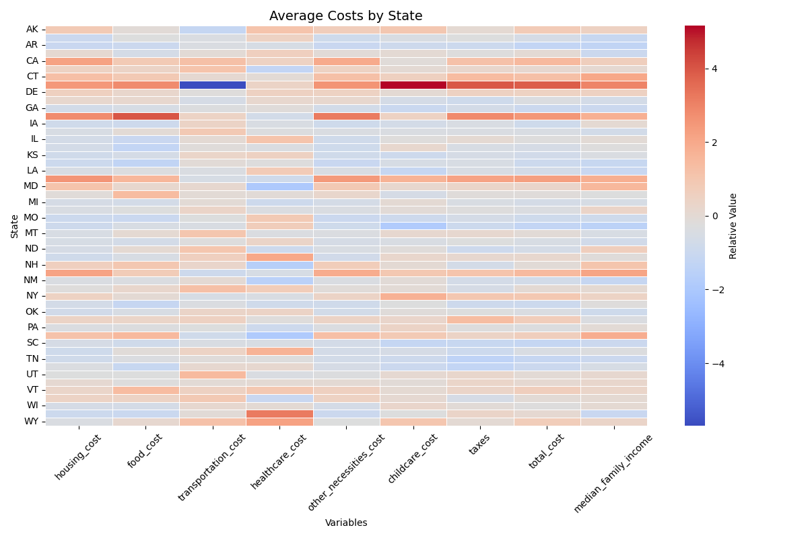
Heatmap by State
Shows relative cost levels
Red = higher, Blue = lower
California and New York show consistent higher costs
Southern states tend to have overall lower costs
Childcare and housing vary the most across states

Slide 13
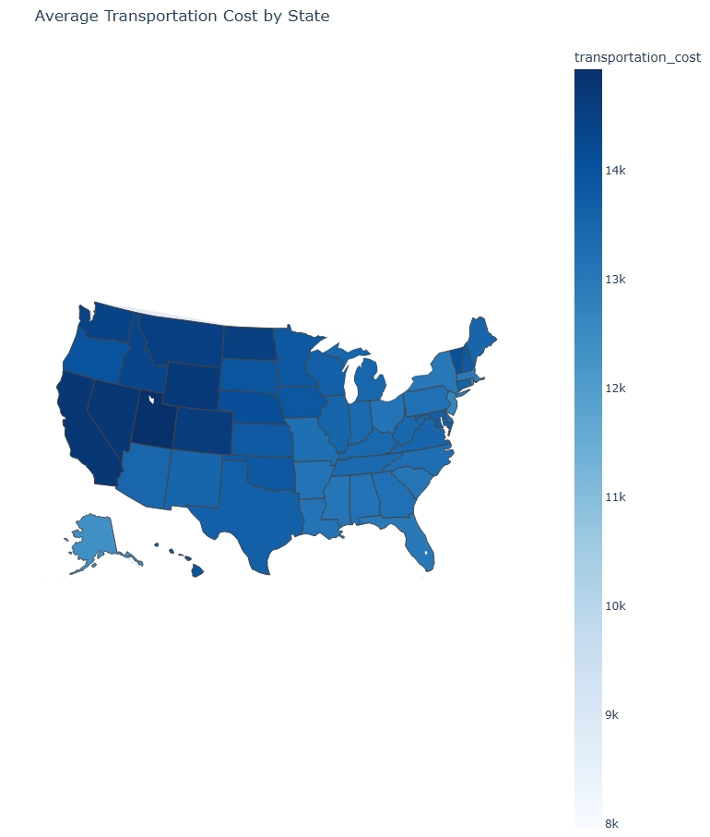
Choropleth Map
Geographic patterns
Higher transportation costs in California and Northeast state
Lower costs in Midwest and Southern regions

Slide 14
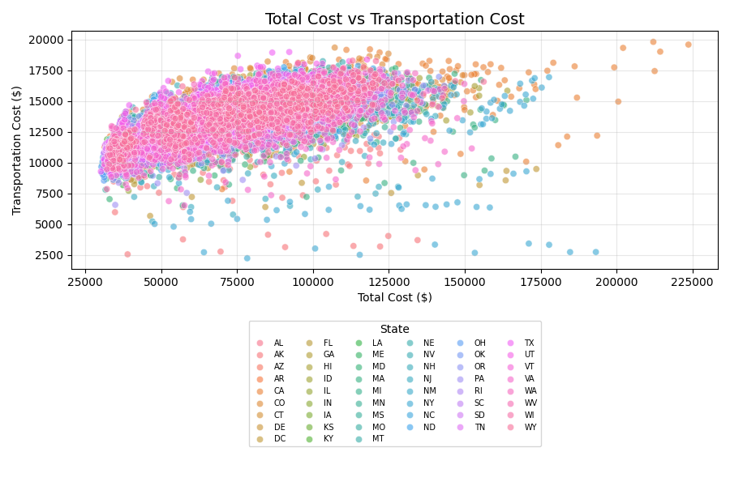
Total vs Transportation
Positive relationship
Higher total cost increases transportation

Slide 15
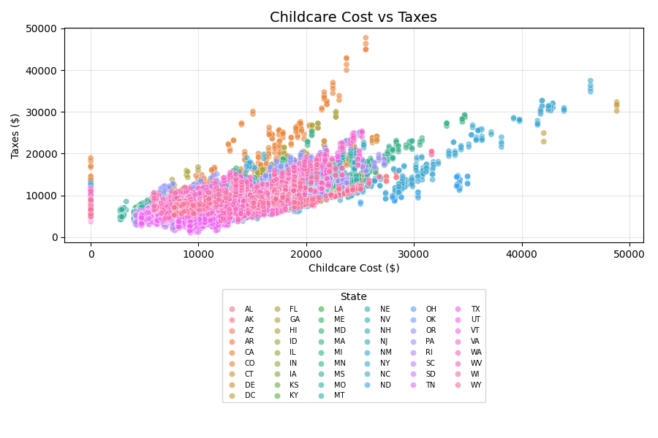
Childcare vs Taxes
Strong upward trend
Areas with higher childcare costs tend to have higher taxes, especially in urban regions

Slide 16
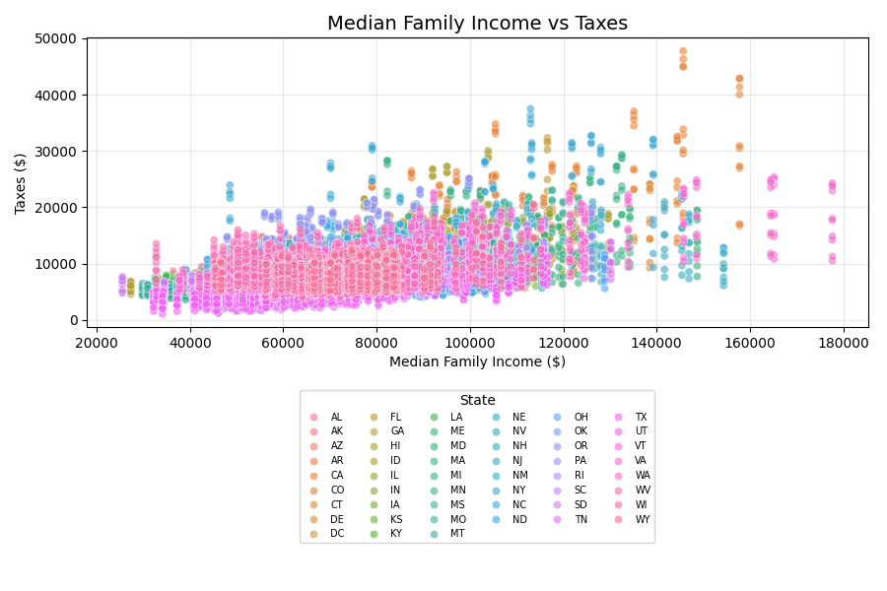
Income vs Taxes
Higher income leads to higher taxes

Slide 17
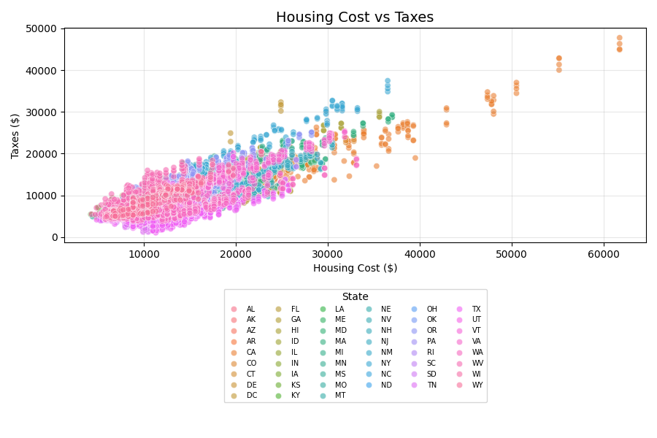
Housing vs Taxes
Strong positive relationship
Housing cost is one of the strongest factors related to higher taxes

Slide 18
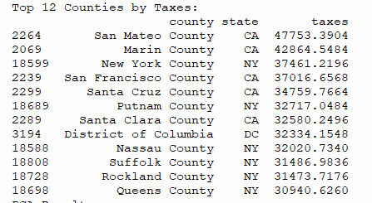
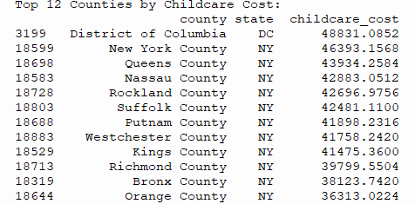
Top Counties by taxes and childcare costs
Mostly NY, CA, and some DC
Costs concentrated in metro areas

Slide 19
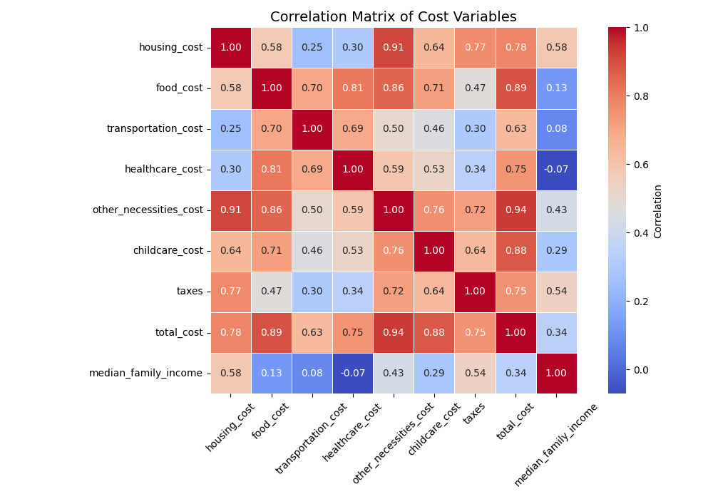
Correlation Matrix
Strong relationships
Total cost linked to most variables

Slide 20
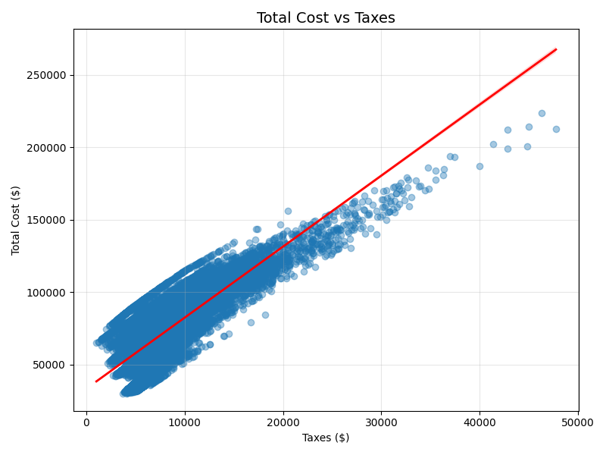
Regression
Clear positive trend
Taxes increase with total cost

Slide 21
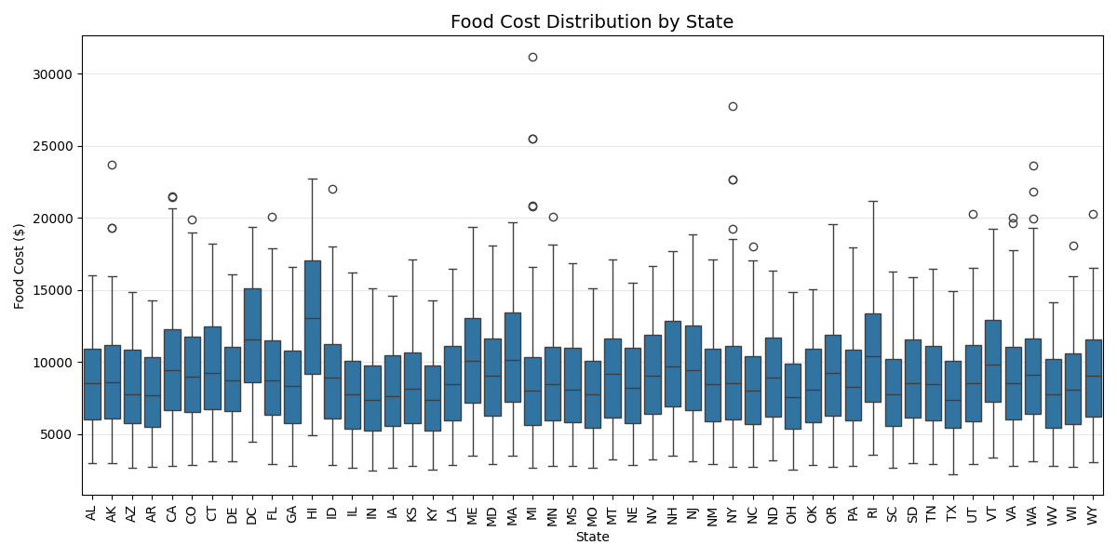
Food Cost Distribution by State
Several high outliers
Widespread across states

Slide 22
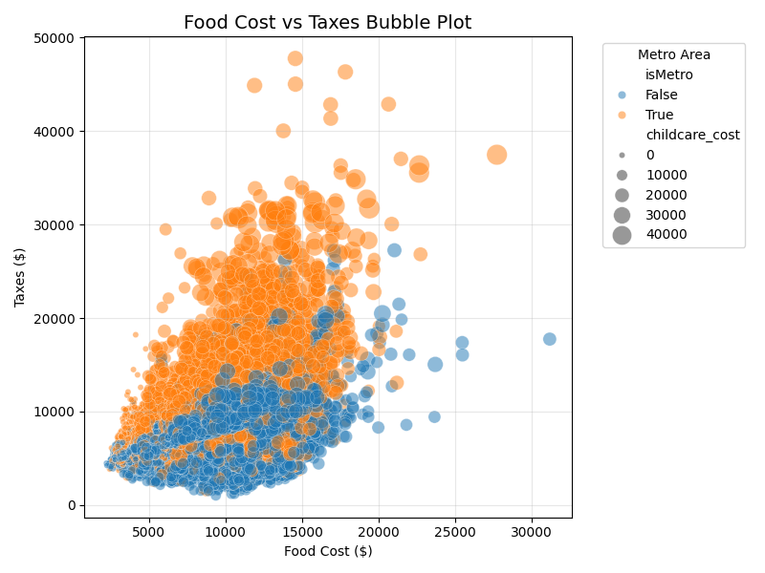
Food Cost vs Taxes Bubble Plot
Larger bubbles = higher childcare
Metro areas higher

Slide 23
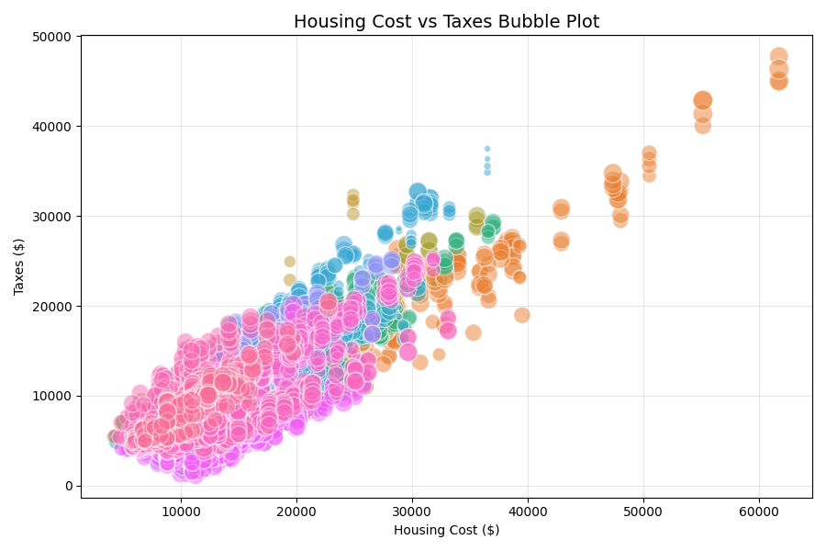
Housing Cost vs Taxes Bubble Plot
Larger bubbles = higher childcare
Metro areas higher

Slide 24
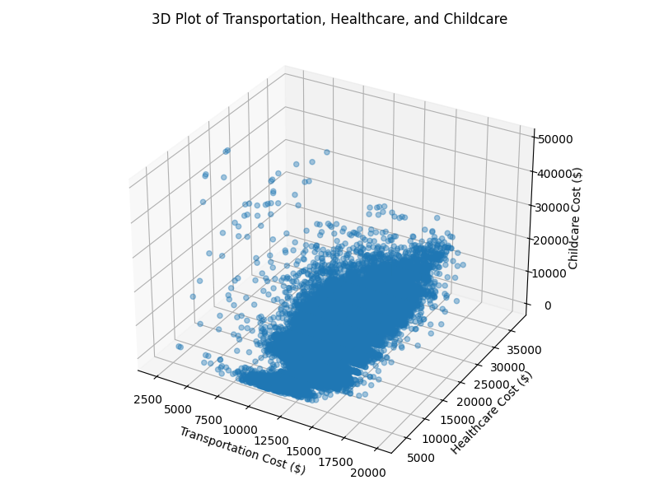
3D Plot of Transportation, Healthcare, and Childcare
These variables increase together, showing overall cost clustering.

Slide 25
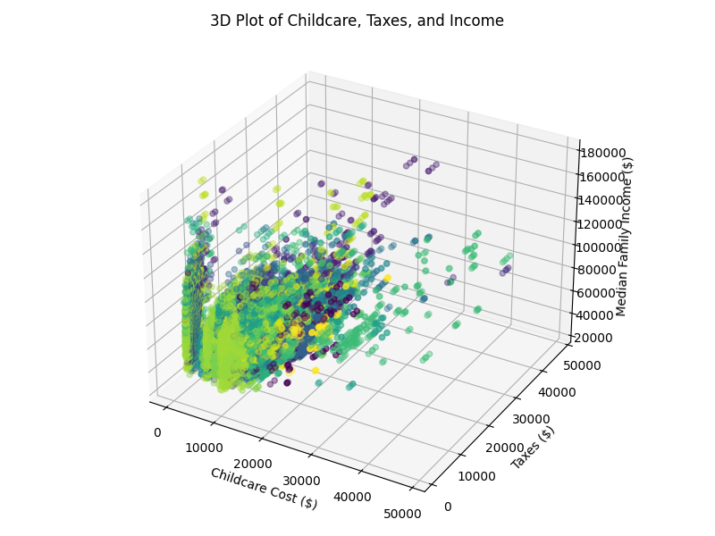
3D Plot of Childcare, Taxes, and Income
Higher income areas consistently align with higher childcare costs and taxes.

Slide 26
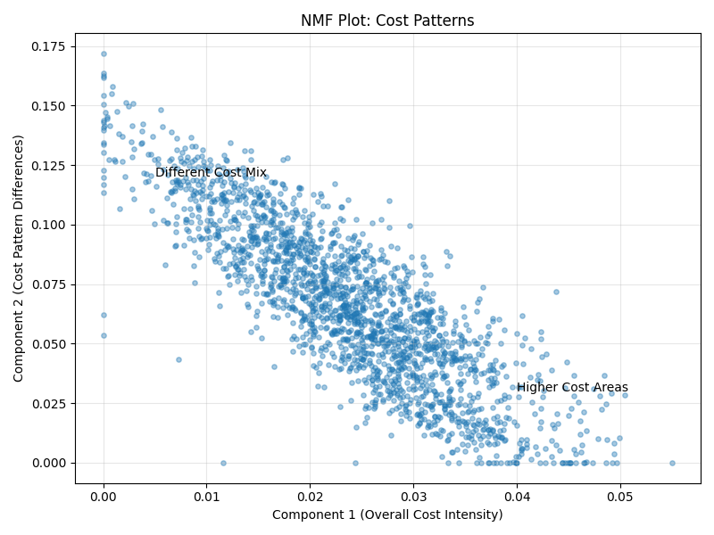
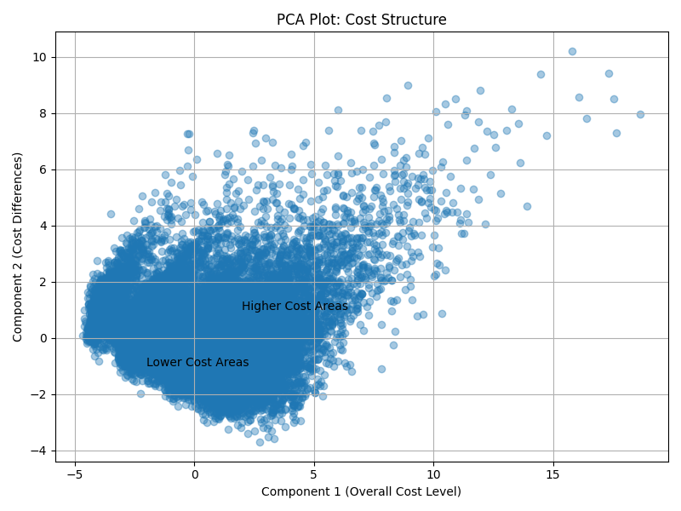
PCA and NMF
PCA shows overall cost levels across areas
NMF highlights differences in cost patterns
Most areas follow similar cost structures
Higher-cost areas cluster together

Slide 27
Conclusion
Cost of living is highest in urban and metropolitan areas, especially in states like California, New York, and Washington D.C.
Housing and childcare costs are the biggest drivers of overall cost differences across regions
Strong positive relationships exist between income, taxes, and total cost
Most cost variables move together, indicating a consistent cost structure across locations

